Slide 1
DMC Presentation: Learning with Felix Cobbold: Christchurch Mansion
Willoughby Axtell & Lenneth Dayaon
Presentation by Willoughby Axtell
Notes:
Hello,
Welcome to my presentation for the design masterclass project
This presentation will detail the process behind the game that Len and Myself created over the past year for the Christchurch mansion

Slide 2
The Brief
The objective of this project was to create a game for use by the Christchurch mansion to try and add an interactive experience to the mansion.
The power of Storytelling
The target audience of this game is young people (14-25) and families.
Notes:
[Read Text] 1 +2
The brief was referred to as the “power of storytelling” and had a focus on creating an interactive story within the game
[Read Text] 3
Its important to note that an additional aspect of the brief was that the game could not interfere or overshadow the experience

Slide 3
Research
We conducted research by visiting the mansion and taking notes on the contents and details about various rooms in the mansion.
Further research was also preformed by researching the history of the mansion online.
Using the research acquired we could make decisions on what aspects of the mansion to use in our game.
Notes:
Read text
The research we conducted by visiting the mansion allowed us to gather lots of information about what each room was used for and we could use this data to come up with ideas for the game

Slide 4
Our Solution to the Brief
Our solution to the brief was to create an interactive learning experience that helps to reinforce information learnt at the museum without detracting from the experience.
We decided to target the family portion of the brief’s target audience.
Notes:
The reason for this is that it is generally more effect to market educational games to children and families.

Slide 5
Game Ideas
Construction Game – Building the museum using the players knowledge to build each room.
Survival/”Virtual Pet” Game – Helping a character survive the late 1500s when the mansion was built by providing the character with useful equipment
Mystery Game – A point and click adventure focused on solving a mystery using information learnt from the mansion
AR quiz - A quiz game that would make use of a phones camera to display questions by pointing it at QR codes in the mansion itself.
Notes:
Top 3
All these would use information learnt from visiting the mansion and the game could be played after leaving
AR quiz
This would be played while navigating the mansion to add an interactive experience to some of the exibits

Slide 6
Final Game Concept
The game that we designed for this project was a minigame collection with each minigame focusing on a different room of the museum.
The core game loop involves completing these minigames in order to unlock new minigames in an order similar to that of what you would normally take while venturing the museum.
The game could be played as you travel through the museum or after leaving as a review on what's learnt.
Notes:
Read slide

Slide 7
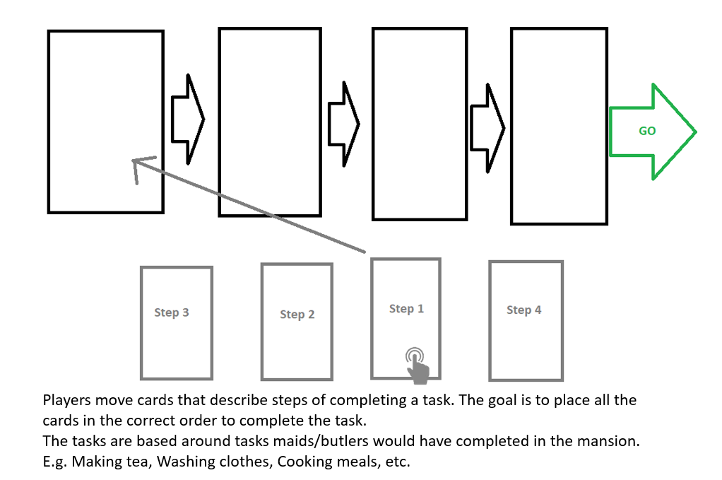
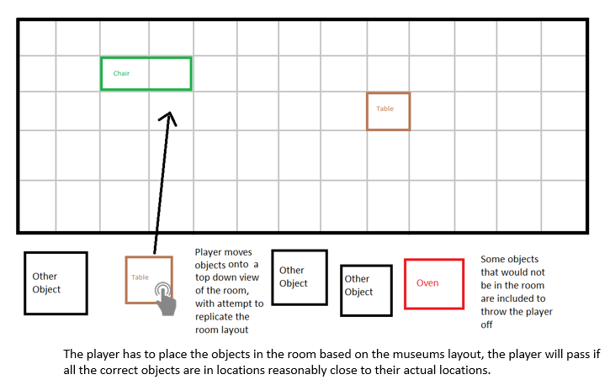
Paper Prototyping
Concepts for minigames, art style, characters and story were all designed and through discussion we agreed on which paper prototypes would be used in the eventual game
Notes:
Read slide
These are 2 of the minigames that I designed for the game, the one of the right eventually made it into the final game

Slide 8
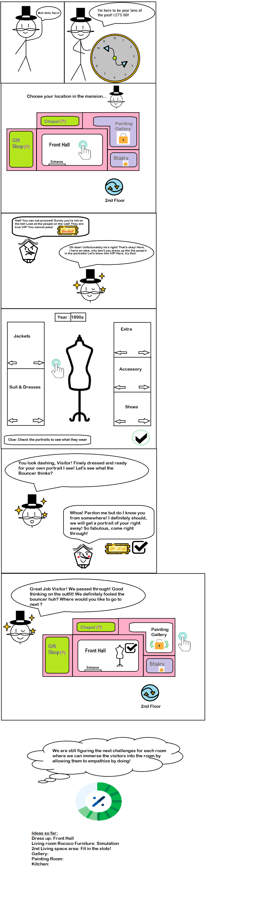
Notes:
Here are some of the paper prototypes created by my group member, this shows how the map would work alongside the introductory story/characters for the game.
In the bottom left another minigame that made it to the final game is shown

Slide 9
Software
Unreal Engine 4 – Game Dev Software of Choice
Github – Used to share files between Group Members
Photoshop – Used for production of Art Assets
Microsoft Outlook – Used to communicate with client
Discord – Used for online group meetings
Microsoft Office – Used for various documents and presentations throughout the project
Notes:
Here is a short list of all the software that we used over the course of the project and what we used each for

Slide 10
Pitching
After coming up with a game concept and putting together a very basic prototype we had to pitch the game idea in front of our client.
This involved creating a presentation that detailed the gameplay as well and the technical details of the game.
Overall this presentation went very well and I felt that our client had a good understanding of the project from it.
Notes:
Read text
After the presentation our client contacted us for a copy of the presentation and commended us on the idea which I believe demonstrates that the pitch was effective

Slide 11
Communication
After pitching and gaining approval for our game concept we retained contact with Melanie.
We could not maintain active regular communication with our client.
This was due to long delays for responses from Melanie.
Notes:
Line 1 +2
However while we made sure to keep our client informed about the state of the project, we could not maintain active regular communication with our client.
Line 3
When we did have active contact with Melanie we made sure to provide detailed explanative documents for game components she was interested in.

Slide 12
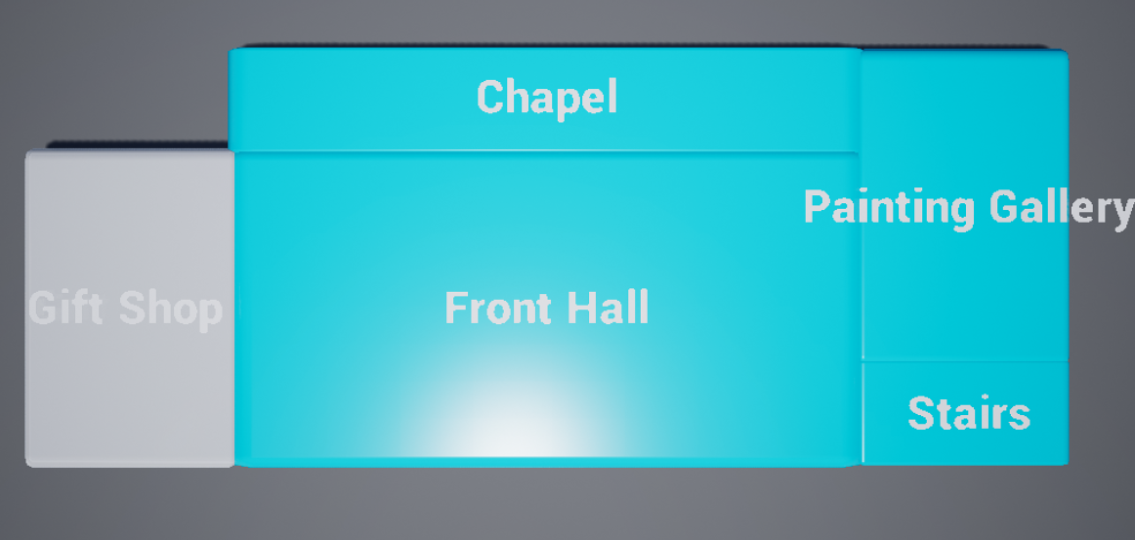
Prototyping
I created a navigation system between the various minigames as well as rough prototypes for the some of the minigames that we designed in the paper prototyping phase.
Notes:
At this early stage in development we had not yet implemented systems such as tracking the number of completed minigames as well as some of the minigames being unfished. These were completed before the final prototype however.

Slide 13
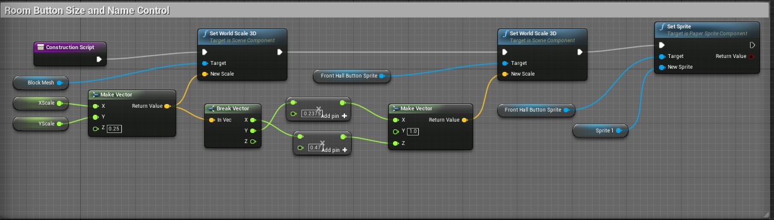
Prototype Scripting: Map
Notes:
Here are some snippits from the blueprints for the prototype
Here are the blueprints for the map
Navigation between rooms was done with default unreal functions but adding creating a system that allowed for rooms to vary required custom blueprints as shown here.

Slide 14
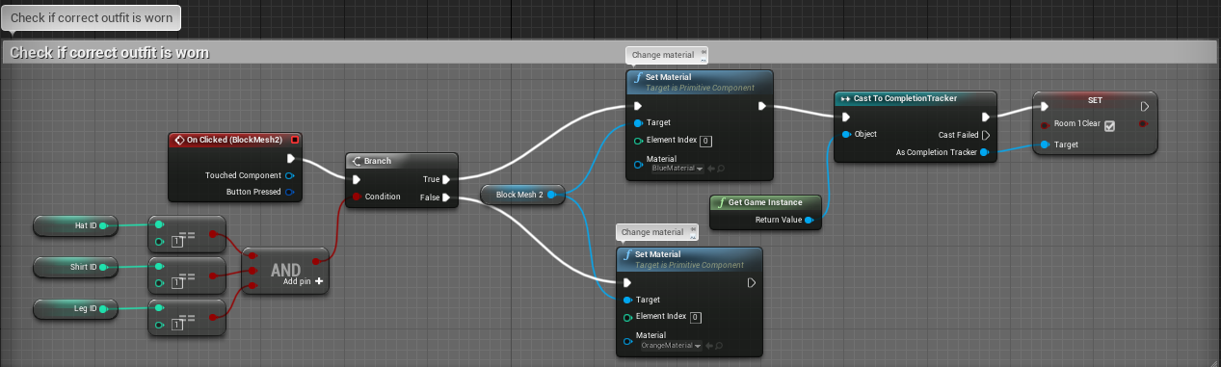
Prototype Scripting: Outfit Minigame
Notes:
Here are the blueprints for the outfit minigame
Here the checking system and the outfit system can be seen, this is used to make sure the correct outfit ID is in each slot.

Slide 15
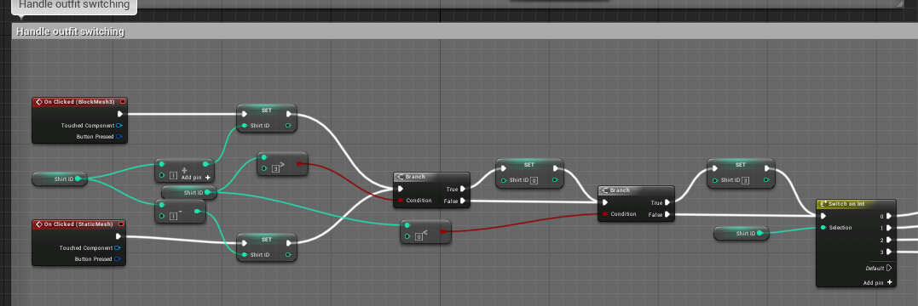
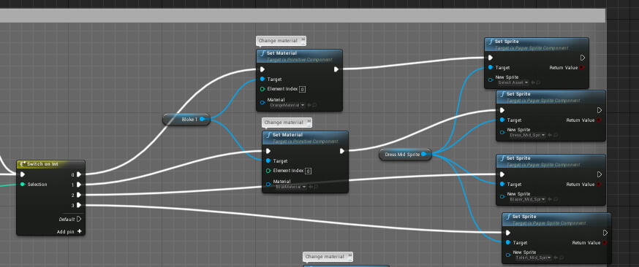
Prototype Scripting: Outfit Minigame
Notes:
This slide shows the system used to switch between outfits for the shirt section.
DO SOME ANIMATION WIZARDRY HERE

Slide 16
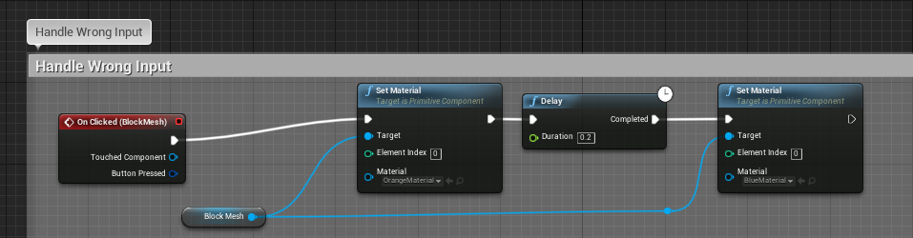
Prototype Scripting: Odd One Out Minigame
Notes:
Here are the blueprints for the odd one out minigame
This was the simplest minigame to program in the collection as it uses the same system as the map but with only one correct button.

Slide 17
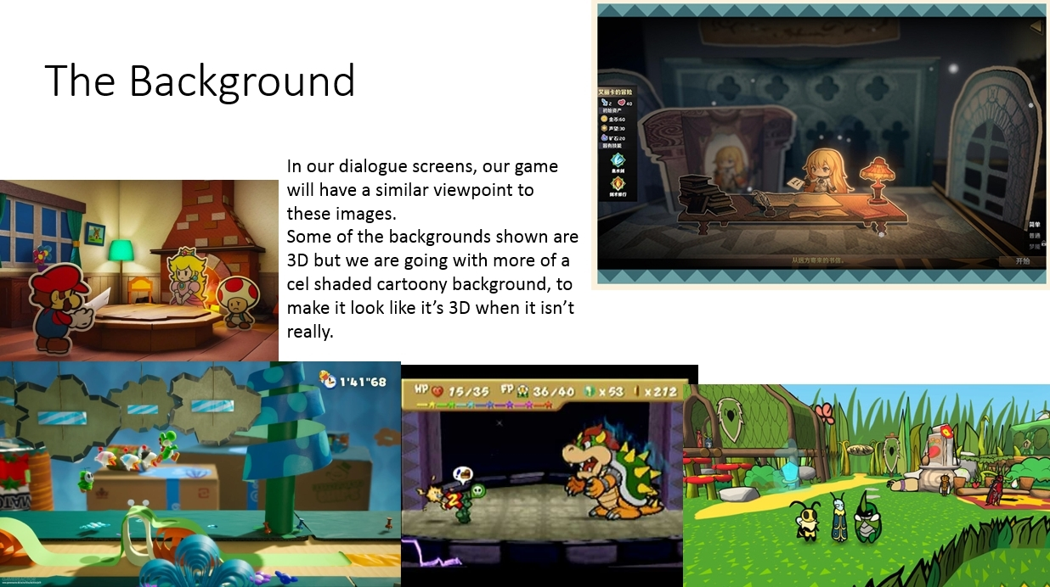
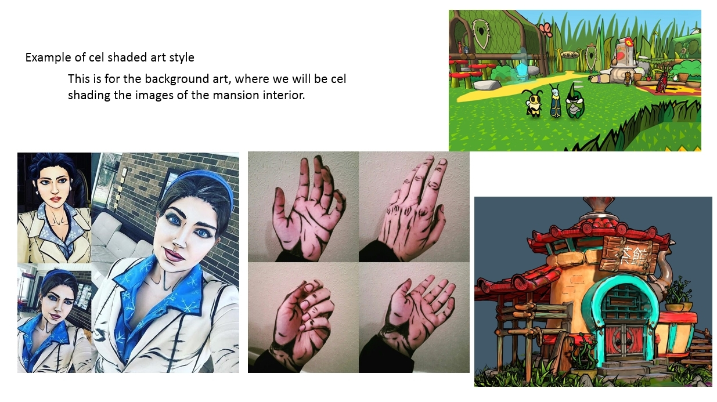
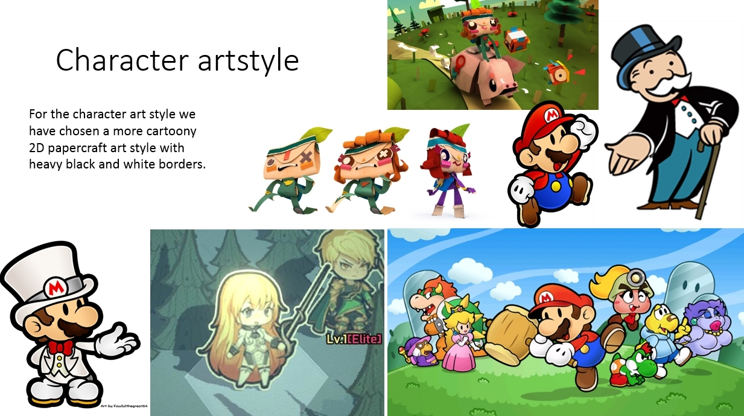
Art Style
During development our client was interested in what art style we intended to use.
During a group meeting we decided on using a papercraft cel-shaded art style.
The client responded by email with praise for the art style we chose.
Notes:
Read Slide

Slide 18
Notes:
The reason we chose this art style was that through research we found that young individuals generally respond well to a storybook athsteic
Assets created in this art style would also be reasonably easy to create due to the primary use of flat colours
It also allows us to use photographs of paintings in the museums without breaking the art style as a realistic painting wont look too far out of place in an environment where everything is paper or cardboard

Slide 19
Notes:
The reason we chose this art style was that through research we found that young individuals generally respond well to a storybook athsteic
Assets created in this art style would also be reasonably easy to create due to the primary use of flat colours
It also allows us to use photographs of paintings in the museums without breaking the art style as a realistic painting wont look too far out of place in an environment where everything is paper or cardboard

Slide 20
Notes:
The reason we chose this art style was that through research we found that young individuals generally respond well to a storybook athsteic
Assets created in this art style would also be reasonably easy to create due to the primary use of flat colours
It also allows us to use photographs of paintings in the museums without breaking the art style as a realistic painting wont look too far out of place in an environment where everything is paper or cardboard

Slide 21
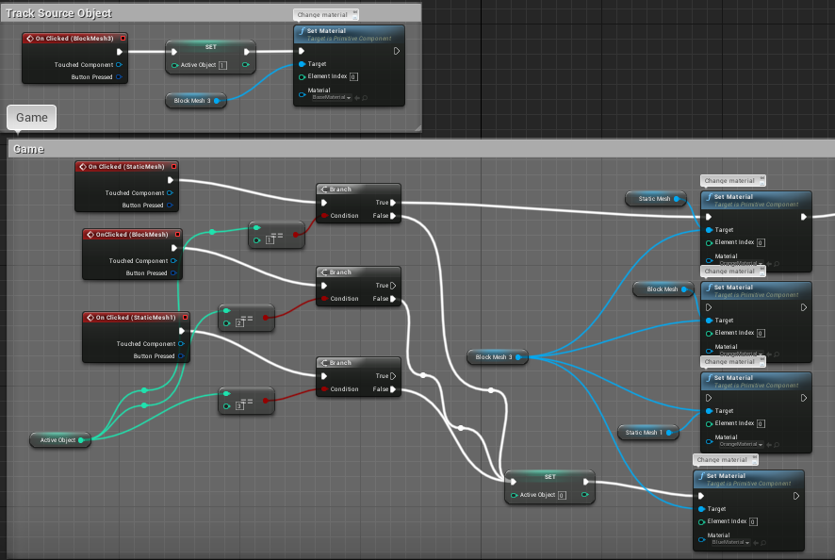
Scripting: Fact Matching Minigame
Notes:
At this point more minigame development occurred
Here are the blueprints for the matching minigame
The “Track Source Object” blueprints are included for modularity sake if more than one input was needed for a pair it can be used.
The rest of the blueprint runs the game via comparing various values.

Slide 22
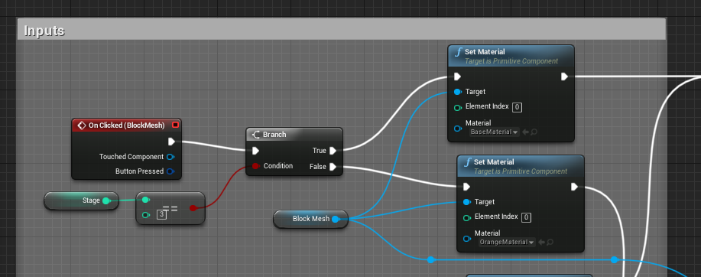
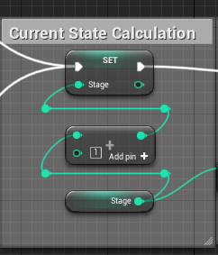
Scripting: Timeline Minigame
Notes:
Here are the blueprints for the Timeline minigame
Each button features an input that checks which buttons have been pressed prior. If the buttons are pressed in the wrong order the game resets. Pressing buttons in the correct order clears the game

Slide 23
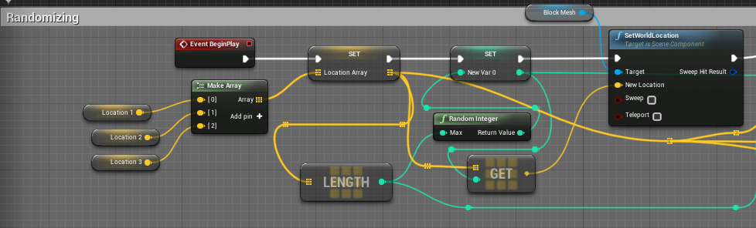
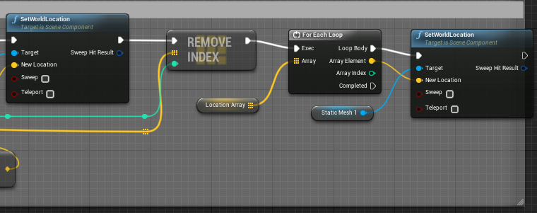
Scripting: Location Randomizer
Notes:
Here are the blueprints for the randomization system used in some of the minigames
It works by repositioning all the buttons in different locations to add slight variety to the game.

Slide 24
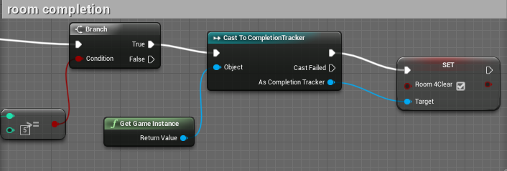
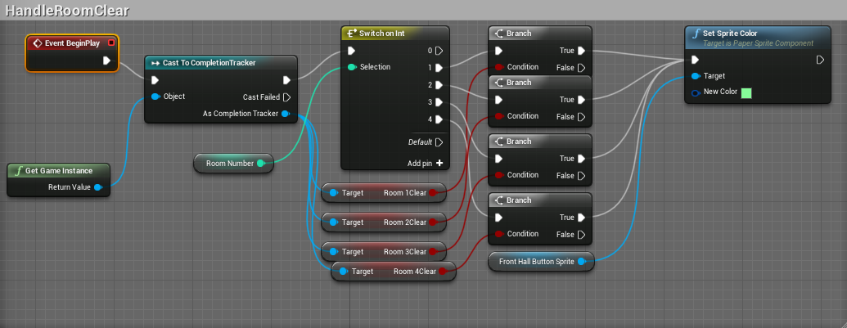
Scripting: Completion Tracking
Notes:
The top blueprints are used to broadcast the completion of a room to the game instance.
The bottom read those values and use them to set the rooms as visually completed.

Slide 25
Project Timeline
Task | Date
Preparing for the project: getting the brief, making a GitHub, gathering a team, going to the Mansion and starting research | Friday 27th September 2019
Come up with initial game concept idea for the brief | Thursday 10th October
Research game ideas, how museums have gone about this, game mechanics and gameplay. | Tuesday 15th October – Saturday 9th November 2019
Creating a design document | Monday 11th November 2019
Making Paper Prototypes & Designing concepts for minigames | Thursday 14th November 2019 – Saturday 23th November 2019
Prototyped the game navigation system | Friday 15th November
Finish designing our pitch | Saturday 23rd November 2019
Presenting our pitch to the client | Monday 25th November 2019
Working on the feedback we were given | Saturday 4th January 2020
Making game assets and working with art style and paper prototypes | Saturday 4th January 2020 – Saturday 11th January 2020
Prototyped 2 mini games | Saturday 22nd February 2020
Created final versions of 4 minigames for the game | Friday 27th March 2020
Created final assets for the game | Friday 3rd April 2020
Creating a list of problems, we faced | Friday 3rd April 2020
Completed the game navigation system and added progress tracking | Sunday 5th April 2020
Began Creating PowerPoint Presentation for our overall DMC experience | Friday 17th April 2020
Notes:
Here is a timeline showing the progress of major milestones in the project
There are large gaps at various points of development, these are because of two reasons
Firstly, delays caused by our client when our client had not responding to critical questions about design decisions
The other due to external delays caused by other projects that the group members were participating in
Towards the end of the project these delays became more infrequent

Slide 26
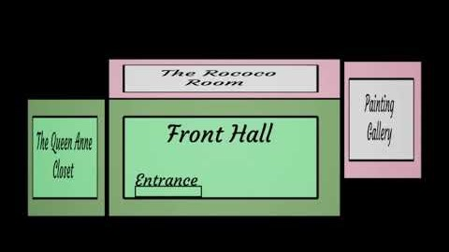
Outcome
Notes:
Wing it

Slide 27
Important Notes
One area of the project that I think needs particular mention is our client leaving the project.
Another thing that could have been handled better is our lack of meeting minutes.
Notes:
Line 1
Unfortunately our client left the project partway into development. While they were satisfied with the prototype we had made at that point it left us with little guidance for the end of the project.
Line 2
All our client “meetings” were done via email and thus did not require minutes. However it would have been ideal for meeting minutes to be produced for group meetings. The reason they were not produced was due to the format of the meetings. All group meetings involved a short discussion of any developments and then working on the project alongside each other, with a short discussion of tasks at the end. The group meetings were more focused on practical work on the project and most things that would normally involve a meeting before design were instead tested or worked on immediately as both group members were in discussion.

Slide 28
Final Product Post-mortem
At this point we have achieved our goal of creating a minigame collection with minigames based off rooms of the museum.
The game features 4 minigames and progress tracking. It also has the potential for more minigames to be added post release.
In terms of improvements, the minigames could use more variety.
The game features a system which randomizes the order options in minigames appears but a person who has played the game through will still be able to complete it with low difficulty.
Notes:
Read Slide
The solution to this would be too add multiple variants of a minigame to a room, which is easily doable however not within our timeframe.

Slide 29
Post-mortem
Overall I think that given the circumstances the project went well.
Due to a few issues with the organization of the group such as the client leaving the project and the lack of tracked meetings the project became somewhat disorganized in areas.
My own contributions to this project were generally focused around programming the game but I also designed some of the minigames and created parts of the presentation and design document.
Notes:
Line 1 +2
I think especially due to the client leaving but also other issues this project could have gone better. Despite the challenges I think the end product turned out to be good as the prototype produced appears to meet the goals set in the original brief and for the duration that our client was with us they seemed to be very happy with the ideas we had put forward
Line 3
Generally due to how the group was managed both members worked on all aspects of the project except for code and art where I did the coding myself and did not create any art assets outside of helping with the original mood boards slightly

Slide 30
Problems Faced
Some major challenges and issues faced across development include:
Map animations
Over scoping
Consistency of Contact
Consistency of Worktime
Informality
Notes:
Map animations – An animation that would have been used to access the 2nd floor was created but was very buggy and took a huge amount of development time despite being unused
Over scoping – The original timeline was proposed in the project pitch showed to be far too overly ambitious. Luckily Melanie agreed with us toning back the scope of the game for the final product.
Consistency of Contact – Due to the lack of contact a lot of development decisions were delayed.
Consistency of worktime – During project development there were regularly large spans of time with little work completed whereas other times would have very large amounts of work completed.
Informality – The management of the group and communication with our client both had a tendency to be rather informal at times. Because of this very little recordkeeping of meetings was preformed and this proved to add challenge to charting a timeline.

Slide 31
Final Comments
Most improvements for the future can be inferred from the various problems faced undertaking this project
Most notably the communication
Time Management
I think that overall the experience with working with an external client has been beneficial. However I think that due to the early end to what little little formal contact with the client we had, this project has be utilized as well as I would like.
Notes:
Line 1
Most notably the communication – Better contact with the client and more formal note keeping of said communication
Time Management – Consistent weekly worktime and better management of the overall worktime would have helped prevent over scoping and tasks going off-track
Read rest
Ideally I would have liked to gain a better experience of a project with an external end user with similar standards to a workplace

Slide 32
Any Questions?
Notes:
Thank you for listening to my presentation
Feel free to email or message me with any questions or queries

Slide 33
Image references for the mood boards
Deviantart.com. 2020. Paper Mario - Wedding Tux By Fawfulthegreat64 On Deviantart. [online] Available at: <https://www.deviantart.com/fawfulthegreat64/art/Paper-Mario-Wedding-Tux-758721432> [Accessed 4 January 2020].
Corporation, R., 2020. Monopoly Man. [online] ROBLOX. Available at: <https://www.roblox.com/library/68832498/monopoly-man> [Accessed 4 January 2020].
Roebuck, M., 2020. Nintendo Announces All Mario To Be Paper By 2025. [online] The Hard Times. Available at: <https://thehardtimes.net/harddrive/nintendo-announces-all-mario-to-be-paper-by-2025/> [Accessed 4 January 2020].
VG247. 2020. Tearaway: The Best Reason To Own A PS Vita? - VG247. [online] Available at: <https://www.vg247.com/2013/11/20/tearaway-the-best-reason-to-own-a-ps-vita/> [Accessed 4 January 2020].
Discussion, G., 2020. Tearaway Unfolded E3 Trailer. [online] NeoGAF. Available at: <https://www.neogaf.com/threads/tearaway-unfolded-e3-trailer.1064467/page-2> [Accessed 4 January 2020].
Deviantart.com. 2020. Paper Mario (Jumping) Remake By Fawfulthegreat64 On Deviantart. [online] Available at: <https://www.deviantart.com/fawfulthegreat64/art/Paper-Mario-Jumping-Remake-756142242> [Accessed 4 January 2020].
Papercraft, 纸., 2020. 纸境英雄 Papercraft On Steam. [online] Store.steampowered.com. Available at: <https://store.steampowered.com/app/905660/_Papercraft/> [Accessed 4 January 2020].
Polygon. 2020. Report: Paper Mario: Color Splash Leaks In Full Two Weeks Ahead Of Release. [online] Available at: <https://www.polygon.com/2016/9/23/13028328/paper-mario-color-splash-leaks> [Accessed 4 January 2020].
Romano, S., 2020. Adventure RPG Bug Fables Announced For PS4, Switch, And PC - Gematsu. [online] Gematsu. Available at: <https://gematsu.com/2019/05/adventure-rpg-bug-fables-announced-for-ps4-switch-and-pc> [Accessed 4 January 2020].
Youtube. 2020. Paper Mario Battle: Final Battle Bowser. [online] Available at: <https://www.youtube.com/watch?v=mPasnNb9Xfg> [Accessed 4 January 2020].
Skidrow Cracked. 2020. FREE DOWNLOAD » 纸境英雄 Papercraft | Skidrow Cracked. [online] Available at: <https://skidrowcracked.com/%E7%BA%B8%E5%A2%83%E8%8B%B1%E9%9B%84-papercraft/> [Accessed 4 January 2020].
Pinterest. 2020. 1,487 Likes, 17 Comments - Jennifer (@Goldvestercosplay) On Instagram: “(Me Hoping That Snow Has A New Outf… | Cartoon Outfits, The Wolf Among Us, Cosplay. [online] Available at: <https://www.pinterest.com/pin/516365913519259481/> [Accessed 4 January 2020].
Pinterest. 2020. Bit Of Cel-Shading On My Hands The Other Day! | Hand Makeup, Borderlands Cosplay, Back Of Hand. [online] Available at: <https://www.pinterest.com/pin/527132331364670264/?lp=true> [Accessed 4 January 2020].
Pinterest. 2020. Embellishing A Teapot House With Cel-Shading | Cell Shade. [online] Available at: <https://www.pinterest.com/pin/727823989762389365/?lp=true> [Accessed 4 January 2020].

